Slide 1

Covid-19 Spread Breaking Device For Public Places

Slide 2
Raunak Mishra
Student of +2 at St. Xavier’s College, Maitighar, Kathmandu
Contact No.: 9819871647
Email Address: kumarraunak077@gmail.com
Address: Zeromile-7, Janakpurdham, Dhanusha, Province 2, Nepal

Slide 3
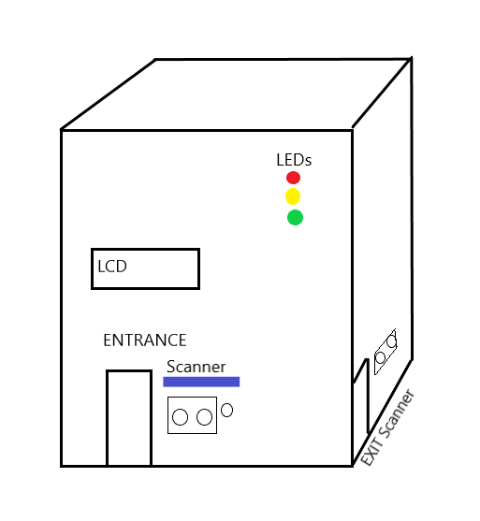
Outer Plan

Slide 4
Materials Required
1. | Instruments/Hardwares | S.N. |  | Estimated Cost(In NRs)
 |  | a. | Arduino UNO R3 | 900
 |  | b. | HC-SR04 × 2 | 250 × 2 = 500
 |  | c. | MLX90614 | 2500
 |  | d. | LEDs × 3 | 10
 |  | e. | Motors | 1500
 |  | f. | L298N Motor Driver | 450
 |  | g. | LCD | 500
 |  | h. | Battery | 100
 |  | i. | Switch | 20
 |  | j. | Resistors × 10 | 10
 |  | k. | Potentiometer(POT) | 20
2. | Software
 |  | a. | Arduino IDE | 0
3. | Machinery
 |  | a. | Soldering Iron | 220
 | Total |  |  | 6730

Slide 5
I2C Communication
Specifications
Wires Used | 2
 | Standard Mode = 100Kbps
 | Fast Mode = 400Kbps
 | High Speed Mode = 3.4 Mbps
 | Ultra fast Mode = 5 Mbps
Synchronous or Asynchronous? | Synchronous
Serial or Parallel? | Serial
Maximum of Masters | Unlimited
Maximum of Slaves | 1008

Slide 6
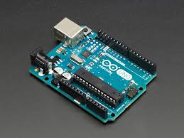
Components Details
Arduino UNO :
Arduino is an open-source electronics
platform based on easy-to-use hardware and
software. Arduino is a hardware and
software company, project and user
community that designs and manufactures
single-board microcontrollers and
microcontroller kits for building digital devices.
Arduino board designs use a variety of microprocessors and controllers.
The Uno is one of the more popular boards in the Arduino family based on AVR microcontroller Atmega328.. It has 14 digital input/output pins (of which 6 can be used as PWM outputs), 6 analog inputs, a USB connection, a power jack, a reset button and more. It contains everything needed to support the microcontroller; simply connect it to a computer with a USB cable or power it with a AC-to-DC adapter or battery to get started.

Slide 7
Why Arduino?
Inexpensive
Cross-platform
Simple, clear programming environment
Open source and extensible software
Open source and extensible hardware

Slide 8
Arduino Specifications
Microcontroller | ATmega328
Operating Voltage | 5V
Input Voltage(Recommended) | 7 – 12V
Input Voltage(Limits) | 6 – 20V
Digital I/O Pins | 14(of which 6 are PVM)
Analog Input Pins | 6
DC Current per I/O Pins | 40mA
DC Current for 3.3V Pin | 50mA
Flash Memory | 32KB(of which 0.5KB is bootloader)
SRAM | 2KB
EEPROM | 1KB
Clock Speed | 16MHz

Slide 9
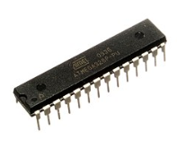
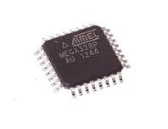
ATmega328
CPU Type | 8-bit AVR
Performance | 20MIPS at 20Hz
Flash Memory | 32KB
Flash Memory | 2KB
EEPROM | 1KB
Pin Count | 28 or 32
Max. I/O Pins | 23
Max. operating frequency | 20MHz
Number of touch channels | 16
External interrupts | 2
USB Interface | No
Atmega328P 28 Pin Linear
ATmega328P 32 Pin Quad

Slide 10
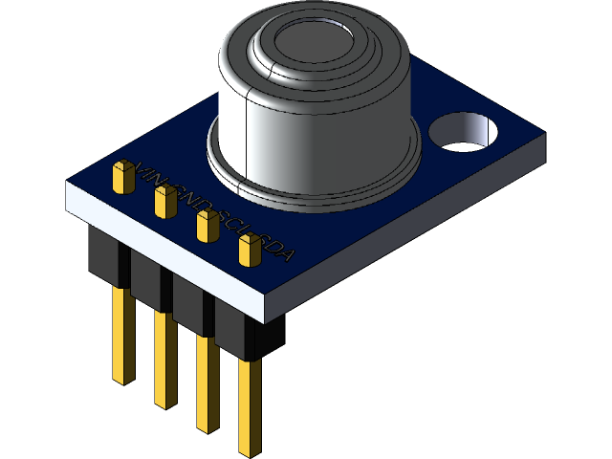
MLX90614 IR Temperature Sensor
The MLX90614 is an Infra Red thermometer for non contact temperature measurements.
Operating Voltage | +3.6 - +5V
Supply Current | 1.5mA
Object Temperature Range | -70 – 382.2°C
Ambient Temperature Range | -40 - 125°C
Field of View | 80°
Distance | 2 – 5cm

Slide 11
PINS:
Pin | Arduino Connection
Vcc | 5V
GND | GND
SDA | I/O Pins
SCL | I/O Pins

Slide 12
LCD Display
Display Types
TFT LCD display
TFT LCD touchscreen display
Dot matrix
White OLED display
16×2 character LCD display
5110 LCD display
Bits Digital Tube LED display

Slide 13
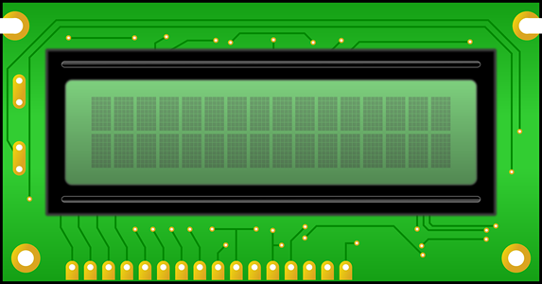
16×2 character LCD display
Operating Voltage | 5V
Controller | Hitachi HD44780 LCD controller
Screen Resolution | 2-lines × 16 characters
Character Resolution | 5 × 8 pixels
Viewing Area Dimensions | 64.5 × 16.4 mm

Slide 14
LCD Pins
LCD Pin | LCD Pin No. | Arduino Connections
Vss | 1 | GND
Vdd | 2 | 5V
V0 | 3 | POT
RS | 4 | I/O Pins
R/W | 5 | GND
E | 6 | I/O Pins
D0 – D3 | 7 - 11 | No Connection
D4 – D7 | 11 – 14 | I/O Pins
A (LED+) | 15 | 5V
K (LED-) | 16 | GND

Slide 15
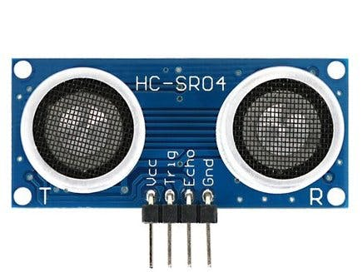
HC-SR04 Ultrasonic Sensor
It works on the principle of reflection of waves using Ultrasonic waves.
Operating voltage | +5V
Theoretical Measuring Distance | 2 – 450cm
Practical Measuring Distance | 2 – 80cm
Accuracy | 3mm
Measuring angle covered | <15°C
Operating Current | <15mA

Slide 16
PINS:
Pins | Arduino Connection
Vcc | 5V
GND | GND
Trig | I/O Pins
Echo | I/O Pins

Slide 17
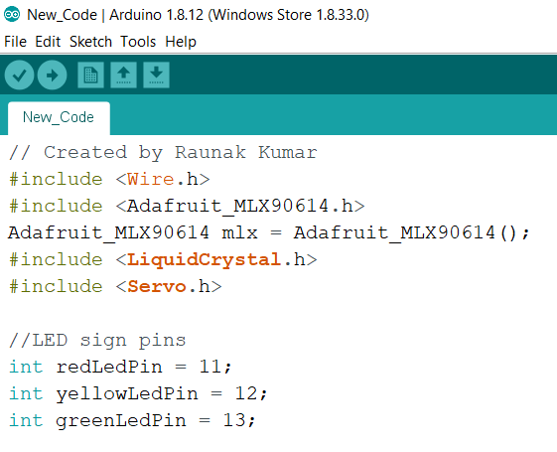
Arduino IDE
The Arduino integrated development environment (IDE) is a cross-platform application (for Windows, macOS, and Linux) that is written in the programming language Java, C and C++ language. It originated from the IDE for the languages Processing and Wiring.

Slide 18
Working
With its start, the LCD will display “Welcome, please follow the instructions and wear your mask.” that’ll remind people to wear masks. Thereafter, the device is assigned with the maximum number of people the place can hold. Now it checks if the number already inside the place is less than the maximum number of people allocated or not.
If not, it’ll turn the Red light on and display “The place is filled, please wait.” then it checks the exit sensor whether someone has scanned or not. If not it displays the red light on and repeats the process but if yes, it decreases the current number of people by 1, starts the servo motor to open the door and turn all the lights on, applies a delay and again returns to check if current number of people is less than the maximum number of people allocated and repeats the loop.
But if the number already inside the place is less than the maximum number of people allocated, the device turns the yellow light on and displays “Place is vacant for ‘maximum number of people allocated - current number of people entered’ of people, please scan yourself to enter.” and then checks the entry sensor whether someone has scanned or not. If not, it’ll check the exit sensor if someone has scanned and turned yellow light on and repeat the process if none has scanned the exit sensor too. But if someone has scanned the exit sensor it decreases the current number of people inside the place by 1, starts the servo motor to open the door and turns all the LEDs on, adds a delay and repeats the loop from the start. But if someone has scanned an entry sensor it checks the temperature sensor and displays “Please enter.” and turns green light on, increases the current number of people by 1, starts the servo motor to open the door, adds a delay and repeats the whole loop again if the temperature is eligible. But if the temperature isn’t eligible to enter, it’ll display “Due to your high body temperature, we can’t allow you to enter inside.” checks the exit sensor and repeats the process.

Slide 19
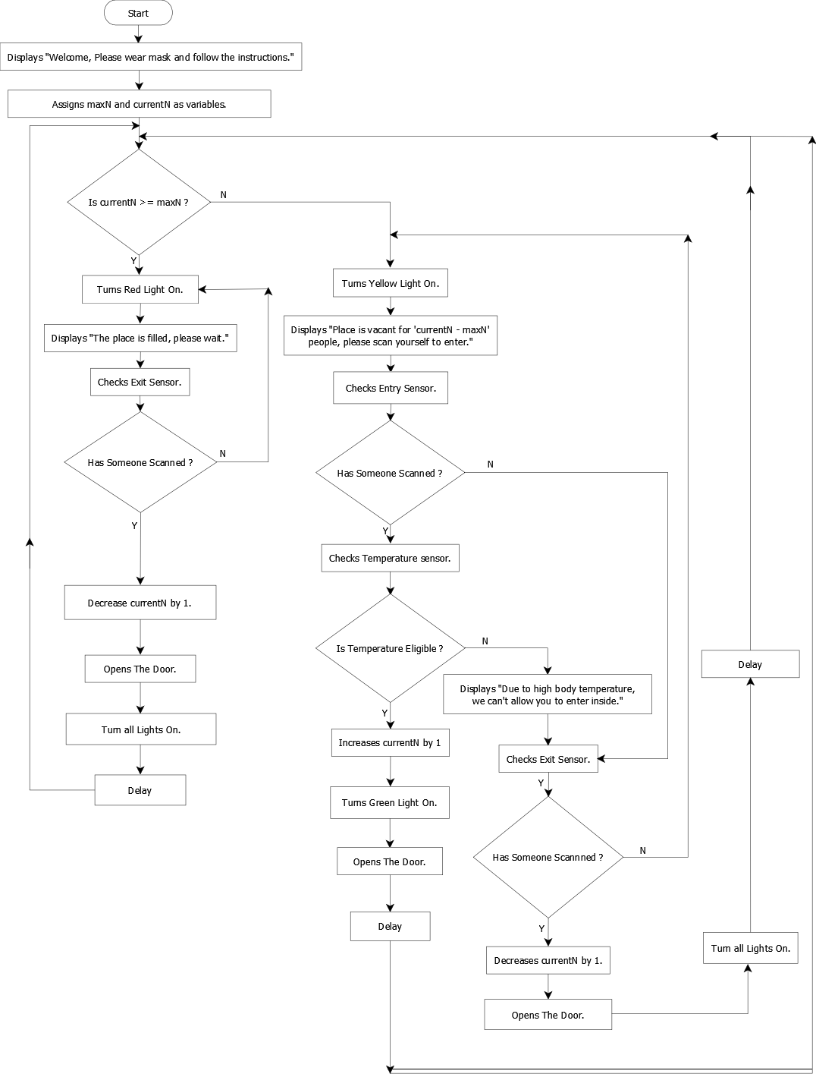

Slide 20
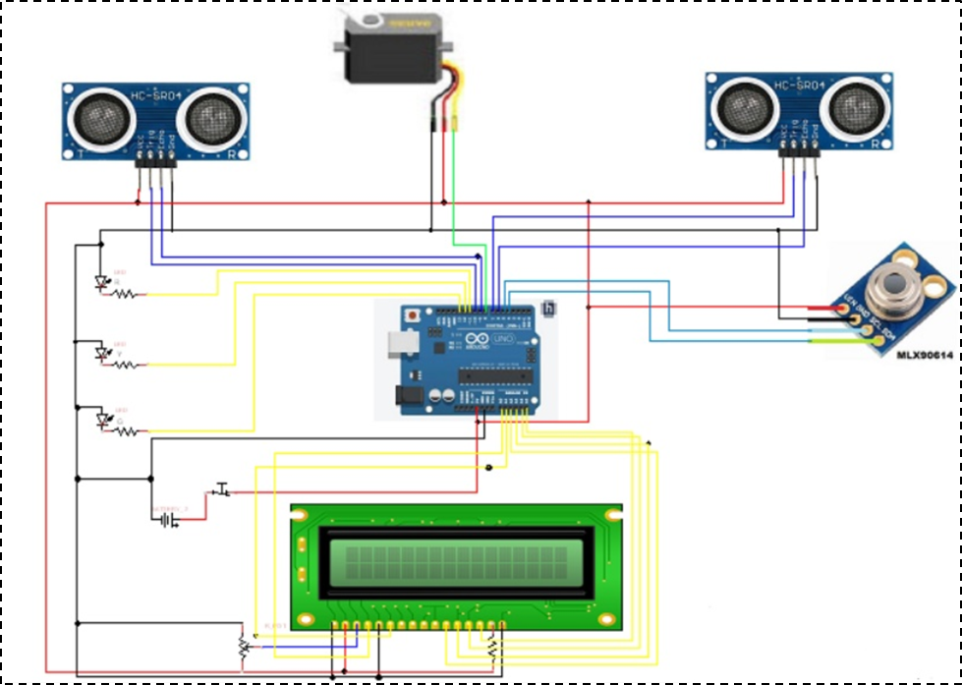
Circuit Diagram

Slide 21
Plan
S.N. | Works to be done | Expected Time Required
1. | Coding and Hardware Buying | 2-3 days
2. | Assembling of Hardwares and Program Uploading | 1 day
3. | Testing | 1 day
4. | Debugging | 2-3 days
5. | Final Installation | 1 day
 | Total | 1 week

Slide 22
Expected Outcomes
Reduced Covid-19 Cases
Automated with zero Human Contact
Restriction of Entry of Susceptible People
Increment in GDP
Restart of the Academic Year
Make People Aware about the Necessity of Personal Safety

Slide 23


